Slide 1
Virginia Department of Health - Immunization Presentation
Erica Hunter, PhD, MPH
Virginia Department of Health
Division of Immunization

Slide 2
Agenda
Resources
Exemptions
Virginia Immunzation Requirements

Slide 3
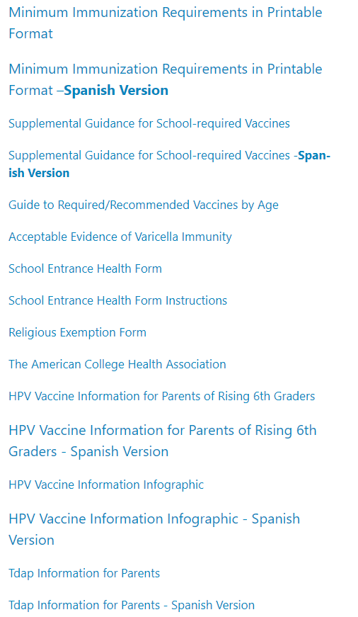
Resources for School Nurses and Administrators
VDH Webpage
Provides information on school-required vaccines
Provides immunization resources
ex: Supplemental Guidance for school-required vaccines, School Entrance Health Form, Religious Exemption Form, etc.
Also, provides the Virginia code related to Immunizations
HPV Information for nurses and parents
https://www.vdh.virginia.gov/immunization/requirements

Slide 4
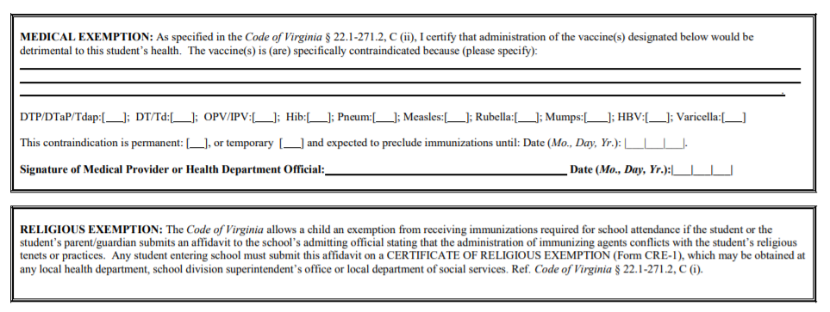
Exemptions
Virginia accepts two types of exemptions:
Medical Exemption -
The school must have written certification from a physician or a local health department on FORM MCH 213G (which can be found within the School Entrance Health Form) that one or more of the required immunizations may be detrimental to the student’s health. Such certification of medical exemption shall specify the nature and probable duration of the medical condition or circumstance that contraindicates immunization.
Religious Exemption -
The student’s parent or guardian submits a CERTIFICATE OF RELIGIOUS EXEMPTION (FORM CRE-1), to the admitting official of the school. Form CRE-1 is an affidavit stating that the administration of immunizing agents conflicts with the student’s religious tenets or practices. The CRE-1 must be signed by a NOTARY PUBLIC AND STAMPED WITH THE NOTARY’S SEAL https://www.vdh.virginia.gov/content/uploads/sites/11/2016/04/cre_1.pdf.
Reminder*** Virginia allows only medical and religious exemptions.
Notes:
Exemptions, in Virginia we accept two form of exemptions, the first is a medical exemption, schools, must have written certification form a physician on the medical exemption form, which is found in the school entrance health form, that one or more of the required immunizations may be detrimental to the students health.
Virginia also accepts a religious, the parents must complete the Certificate of religious exemption form and submit it to the school. The parent must have the form signed and notarized for it to be a valid religious exemption. As mentioned previously, this form can be found on our website.

Slide 5
Immunization Requirements- Effective July 1, 2021
HB 1090:
Amends the minimum vaccination requirements for attendance at a public or private elementary, middle or secondary school, child care center, nursery school, family day care home, or developmental center. The bill also requires the State Board of Health to amend the State Board of Health Regulations for the Immunization of School Children as necessary from time to time to maintain conformity with evidence-based, routinely recommended vaccinations for children.
Changes:
Two doses of properly spaced human papillomavirus (HPV) vaccine (males and females). The first dose shall be administered before the child enters the 7th grade.
Two or three properly spaced doses of rotavirus vaccine, depending on the manufacturer, for children up to eight months of age.
Two properly spaced doses of hepatitis A vaccine (HAV). The first dose shall be administered at age 12 months or older.
Two properly spaced doses of meningococcal conjugate vaccine (MenACWY). The first dose shall be administered prior to entry to 7th grade. The second dose shall be administered prior to entry to 12th grade.
Effective July 1, 2021
Notes:
To align with current Advisory Committee on Immunization Practices (ACIP) recommendations, the 2020 General Assembly passed HB 1090 which amends the minimum vaccination requirements for attendance at a public or private elementary, middle or secondary school, child care center, nursery school, family day care home, or developmental center.

Slide 6
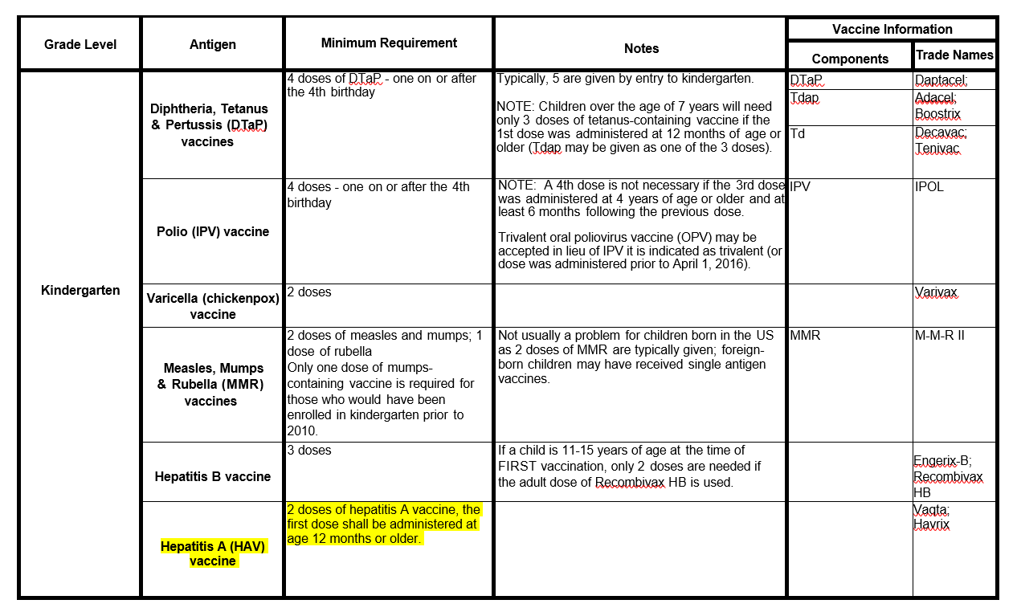
2021-22 Immunization Requirements– KG
Hep A requirement added to the KG requirement
Notes:
Students in grades 1st and above are considered ‘grandfathered’ will not need to receive the kindergarten dose.

Slide 7
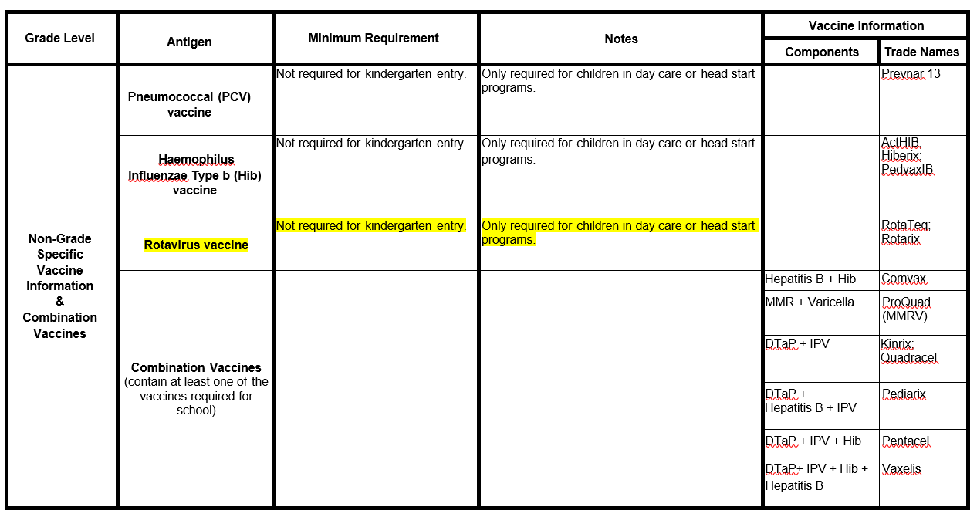
2021-22 Immunization Requirements– Non-Grade Specific
Rotavirus Vaccine will be added to this section, as the maximum age for this vaccine is 8 months

Slide 8
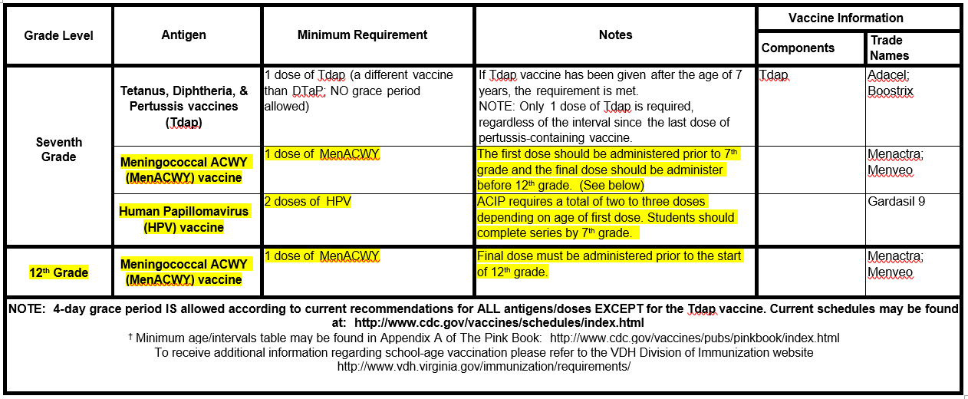
2021-22 Immunization Requirements– 7th Grade/12th Grade
The grade for the HPV requirement will change from 6th grade to 7th grade in 2021, dosing will change from 3 doses to 2 doses and gender will apply to both females and males.
MenACWY, vaccine, will be added to the 7th and 12th grade school requirement in SY 2021-22.
Notes:
8-11th graders ‘grandfathered’ will not need to receive the 7th grade dose, will pick up at the 12th grade dose.

Slide 9
Questions?

