Slide 1
HPV Immunization Strategies
Michael Martin, MD FAAP
President, Virginia Chapter of the AAP
Notes:
Good morning everyone! My name is Mike Martin and I am the president of the Virginia Chapter of the American Academy of Pediatrics and I am very excited to be invited to speak to you all. School nurses and pediatricians go together like mac and cheese. There has not been a time that I can remember when school nurses were more important than now. As we have seen an increasing number of kids with chronic conditions going to school, now enters a pandemic as we struggle to reopen our education centers. You are irreplaceable and often undervalued, but so essential and that is why the AAP chapter will continue to advocate and support for there being a school nurse in every school. However on top of those responsibilities, I wanted to ask for your help in improving the rate and adoption of the HPV vaccine at a time we experienced significant drops in adolescent vaccine rates.

Slide 2
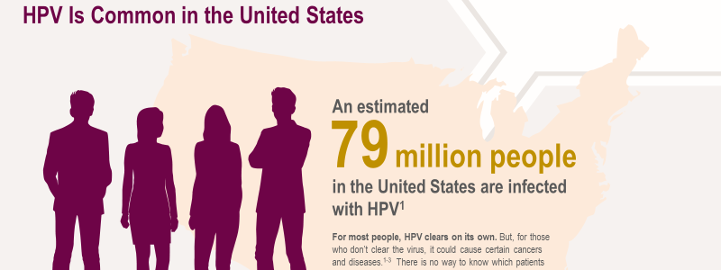
The enemy
Notes:
When this presentation is complete, my goal is that you will be able describe why HPV vaccination is important for cancer prevention, join pediatricians in delivering effective HPV vaccination recommendations and very importantly identify reassuring, confident, and concise responses to parental questions about HPV vaccination.
Now let’s talk about the real enemy, the disease. 79 million people are infected with HPV and 14 million new infections occur every year. Most infection occurs in teens and young adults in their early 20s.

Slide 3
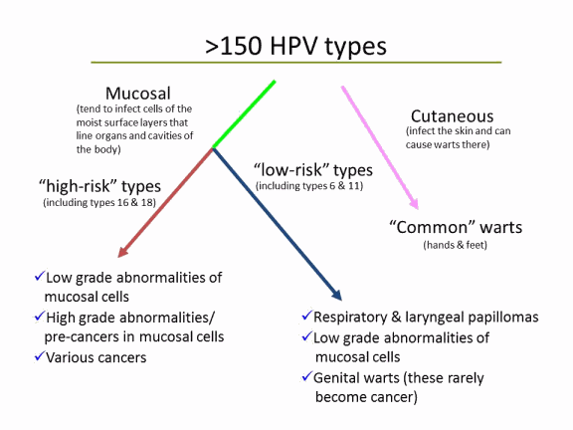
The enemy
Notes:
Human papillomaviruses (HPV) are a very common family of viruses that infect epithelial tissue. HPV types differ in their tendency to infect cutaneous and mucosal or genital epithelium. More than 150 HPV types have been identified, including approximately 40 that infect the genital area. Genital HPV types are categorized according to their epidemiologic association with cervical cancer. High-risk types can cause low-grade cervical cell abnormalities, high-grade cervical cell abnormalities that are precursors to cancer, and cancers. In addition to cervical cancer, HPV infection also is the cause of some cancers of the vulva, vagina, penis, and anus, as well as cancer of the oropharynx and head and neck. . Low-risk types like 6 and 11 can cause benign or low-grade cervical cell changes, genital warts, and recurrent respiratory papillomatosis.

Slide 4
The enemy
Notes:
This chart shows what percentage of cancers by location are caused by HPV. On the left are cancers limited to females including the 3rd most common cancer in females, cervical cancer. On the right you see cancers that can affect males and females with the exception of penile cancer.
Most HPV infections happen during the teen and college-aged years because HPV infection usually occurs soon after sexual debut. Most people never know that they have been infected.

Slide 5
The solution
Notes:
The vaccine while not 100% is pretty darn close and offers a tremendously effective solution for most – if it is given. All available HPV vaccines are made from virus-like particles. The vaccines do not contain any viral DNA and therefore are non-infectious and cannot cause actual disease or cancer. HPV vaccines produce a better immune response than an HPV infection.

Slide 6
HPV Vaccine comparison
Notes:
This chart demonstrates the HPV types targeted by each HPV vaccine. Bivalent HPV vaccine targets two types of HPV, quadrivalent HPV vaccine targets four types of HPV, and 9-valent HPV vaccine targets nine types of HPV. Bivalent, quadrivalent, and 9-valent HPV vaccine all protect against HPV 16 and 18, the HPV types that cause about 66% of cervical cancers and the majority of other HPV-attributable cancers in the United States. Quadrivalent and 9-valent HPV vaccine also protect against HPV 6 and 11, HPV types that cause anogenital warts. In addition, 9-valent HPV vaccine targets five additional cancer-causing types, which account for another 15% of cervical cancers. The additional five types in 9-valent HPV vaccine account for a higher proportion of HPV-associated cancers in women compared with men, and also cause cervical precancers in women. All three vaccines are still licensed in the United States; however, after the end of 2016, however only 9-valent HPV vaccine is currently being marketed in the United States.
While clinical trial data show HPV vaccine has high efficacy for prevention of several of the HPV associated precancers in addition to cervical precancers, no clinical trial data are available to demonstrate efficacy for prevention of oropharyngeal or penile cancers. However, because many of these are attributable to HPV16, the HPV vaccine is likely to offer protection against these cancers as well.

Slide 7
Give at 11-12 years old
Notes:
To recap the HPV vaccine recommendations, both girls and boys can start the HPV vaccine series at age nine. Ideally, preteens should finish the series by their 13th birthday. Everyone ages 13-26 years old who haven’t started or finished HPV vaccine series should also be vaccinated. Also, some adults aged 27 through 45 years can also get the HPV vaccine based on a discussion with their clinician if they were not adequately vaccinated when they were younger.

Slide 8
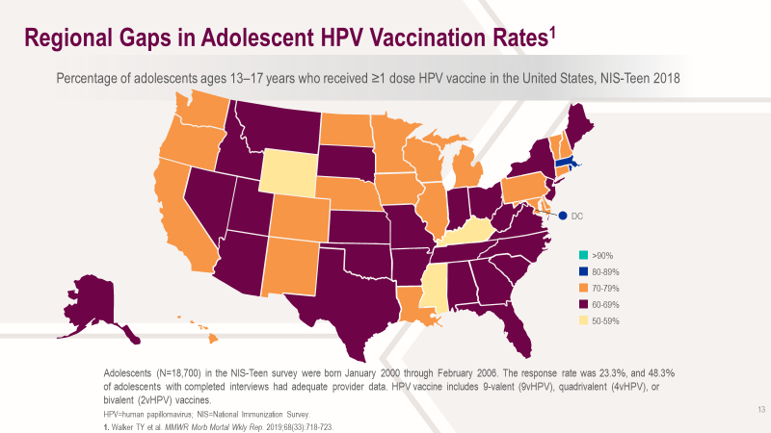
Notes:
Virginia, prior to our pandemic, made modest improvements in vaccination rates, because frankly we were near the bottom.

Slide 9
Notes:
Nationally also, modest improvements but you can see that HPV trails far behind on the other adolescent vaccines as families remain often reluctant to give the vaccine to their child.

Slide 10
COVID AND Vaccine rates
Notes:
Then COVID happened…….and we saw vaccine rates in all kids drop, but nothing reached the levels of drops in vaccines that we saw in adolescents. While I don’t have numbers yet, substantial recovery did occur, and I would tell you that happened in part due to the need to have school forms completed.

Slide 11
HPV Mandate
2008: Code of Virginia required girls entering 6th grade to complete 3 doses of HPV with the first one received prior to entering 6th grade.
2011: 6th grade boys were also recommended (not required) to begin and complete the HPV series.
Unlike other school required vaccines, parents may opt out of HPV vaccine series without documentation.

Slide 12
HB 1090 July 1, 2021
Adds 4 new vaccines to the state’s immunization schedule: Meningitis, hepatitis A, and rotavirus vaccines are now required for all public and private school students, as are human papillomavirus vaccines for boys
It also includes a separate exemption for the HPV vaccine, which parents can refuse after reviewing educational materials on the link between HPV and cervical cancer.
The changes in HB1090 adds boys to the HPV requirement, changes the dose from 3 to 2 and changes the grade requirement from 6th grade to 7th.
There will be no change for families who wish to opt-out of HPV vaccination.

Slide 14
We need your help
Notes:
Effective messaging is about reaching people where it matters to them, its repetitive, its personal. This is an effort we need ALL hands on deck. This includes everyone involved in care participating to counterbalance the disinformation and build confidence around a consistent message about the safety and importance of the HPV vaccine.

Slide 15
Notes:
School nurses have the opportunity to provide a strong recommendation to start. But you can also incorporate other evidence-based strategies to increase HPV vaccine uptake. This includes providing reminders to students and families about when the vaccine series is due, the importance of completing the 2 dose vaccine series, and the importance of completing the series according to the recommended schedule.

Slide 16
Strong message
Notes:
While there is not a requirement, there is a mandate about the HPV vaccine and the choice of words you use, whether spoken or written is critical to success in getting kids vaccinated. While VDH often writes letters, schools can elect to incorporate their own message in notes and communications to families. The message needs to be strongly worded, while you cannot say it is a requirement, you can say that it is needed.

Slide 17
Answer parent questions
Why do boys need the vaccine?
Why give at 11-12 years of age?
Notes:
There are common questions you are likely to be asked and should be prepared for.

Slide 18
For males, not just females
Notes:
1) There is still a residual belief by families that the vaccine is only for females, and this point is important to communicate – HPV vaccine benefits both males and females . Both oropharyngeal and anogenital cancers occur in males.

Slide 19
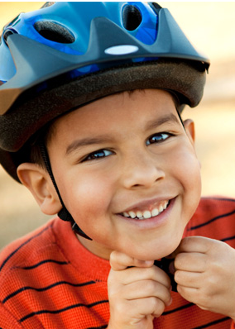
When should the bike helmet go on?
Before they get on their bike
When they are riding their bike in the street
When they see the car heading directly at them
After the car hits them
Notes:
Why give at 11-12 years old?
Most people are familiar with, and endorse the use of bicycle helmets. You could also use seatbelts as an example. Ask parents, “When do you want your children to put on their bike helmets?” Make the point that we can’t guess when the bike accident risk may occur, so we always have our children put on their helmets before getting on their bikes.

Slide 20
What we could achieve
Australia introduced a free national HPV vaccination program in 2007, which consisted of a three-dose vaccine course given to Australian girls aged 12 to 13 at school. The program was then expanded to include boys in 2013 — because they can be carriers of the virus.
In the past eight years, the number of Australian women who contracted HPV fell by 92%.
Precancerous cervical lesions also reduced by 70% for those under 20 years of age and by 50% in women aged 20 to 24.
Australia first introduced a free national HPV vaccination program in 2007, which consisted of a three-dose vaccine course given to Australian girls aged 12 to 13 at school. The program was then expanded to include boys in 2013 — because they can be carriers of the virus.
Notes:
Australia provides us a glimpse of what success in the US can look like. Cervical cancer could be eliminated in Australia within the next two decades because of a government program to vaccinate children against the cancer-causing human papillomavirus. Success in will require higher rates of vaccination

Slide 21
resources
hpv.com (graphics to use)
https://www.immunize.org/hpv/
https://www.cdc.gov/hpv/
https://www.cancer.org/cancer/cancer-causes/infectious-agents/hpv.html

