Slide 1
COVID-19 Zoom Job Aid Updated as of 4/1
How to use ZOOM to schedule a patient visit during COVID-19 pandemic

Slide 2
Table of Contents
1. Instructing staff on how to "schedule" Zoom visits with patients
2. Zoom on a video-enabled laptop or desktop (Slides 5 – 14)
Note: This method will share your email with patients!!
3. Zoom on a mobile device (Slides 15 – 26)
Note: This method will share your cell # with patients!!
4. Patient workflow on a mobile device (Slides 27 – 33)
5. Documentation information (Slide 34)

Slide 3
Zoom vs. VCU Health Anywhere
Zoom and other video conferencing products (Face Time, Doxy.me, Duo etc) can be used to conduct telehealth visits. These are a temporary video-based options to treat and care for your patients given temporary relaxation of HIPAA regulation. (Until June 1).
Due to limited resources and in order to create as much consistency as possible as we seek to educate 1000s of providers, Nursing staff and PARs in a very short period of time the VCUHS Telehealth Team has chosen to focus our educational and support efforts on ZOOM for the next one-two weeks.
VCU Health Anywhere is still our preferred method for virtual telehealth virtual/video-based visits.
In next several weeks we will be sending out emails to targeted clinical groups to inform and help them through transition from Zoom to VCU Health Anywhere. VCU Health Anywhere will enable integrated workflow and enhanced experience both for our providers and patients.
If you have any questions concerning VCU Health Anywhere, Zoom, etc., please contact the Telehealth Team
Email: connectanywhere@vcuhealth.org
Phone: (804) 828-4973 between 8 a.m.- 5 p.m.
You can also join the ZOOM Telehealth Meeting room between 8am – 5pm every day
Zoom meeting room: https://vcuhealth.zoom.us/j/777770841 Meeting ID: 777 770 841

Slide 4
How to Schedule a Zoom Virtual/Video Visit (VV)
Local Clinic Process For Scheduling Telehealth Visits (3/23/20-3/27/20)
Step 1: Providers to review patient list of scheduled patients identifying eligible virtual visit patients.
Step 2: Provider will send list of patients to be seen virtually to local clinic PARs/clinical team member. (Include Practice Administrator)
Step 3: Local clinic PARs to contact patient a minimum of 24 hours before appointment to discuss the need to convert visit to virtual appointment at the request of the provider. For patients who agree, PAR’s convert in-person visit to telehealth appointment type. Local clinic PARs will request email, confirm insurance, confirm demographics, and instruct patient to download zoom app or VCU Health Anywhere. (If app is unavailable, provider will conduct phone call with patient. If patient refuses video/phone visit, local clinic PAR to escalate to Provider for guidance).

Slide 5
How to Schedule a Zoom Virtual/Video Visit (VV) Continued....
Step 4: Clinical team member to call patient 15-20 mins prior to visit to check-in; confirm Zoom or phone visit, ask for weight, BP, concerns, med refills etc. (Clinical team member ensures patient has been arrived in IDX).
Step 5: (If needed) Provider will send ZOOM invite to patient either:
Via email or
send meeting ID through clinical team while they are being checked in by the clinical team member.
Step 6: Provider documents visit encounter under in-person encounter using .telemed_COVID dot phrase for zoom appointments or .telemed_phone-only for telephone appointments.

Slide 6
Zoom on a Video-Enabled Laptop or Desktop
Preferred telehealth pathway 3/18 – 3/27
Use this pathway if you are planning to see patients using your VIDEO-ENABLED LAPTOP OR DESKTOP
Using this pathway restricts invitations to EMAIL ONLY
(The only way to invite patients is via their email address)

Slide 7
Open the zoom application from your VCUHS desktop

Slide 8
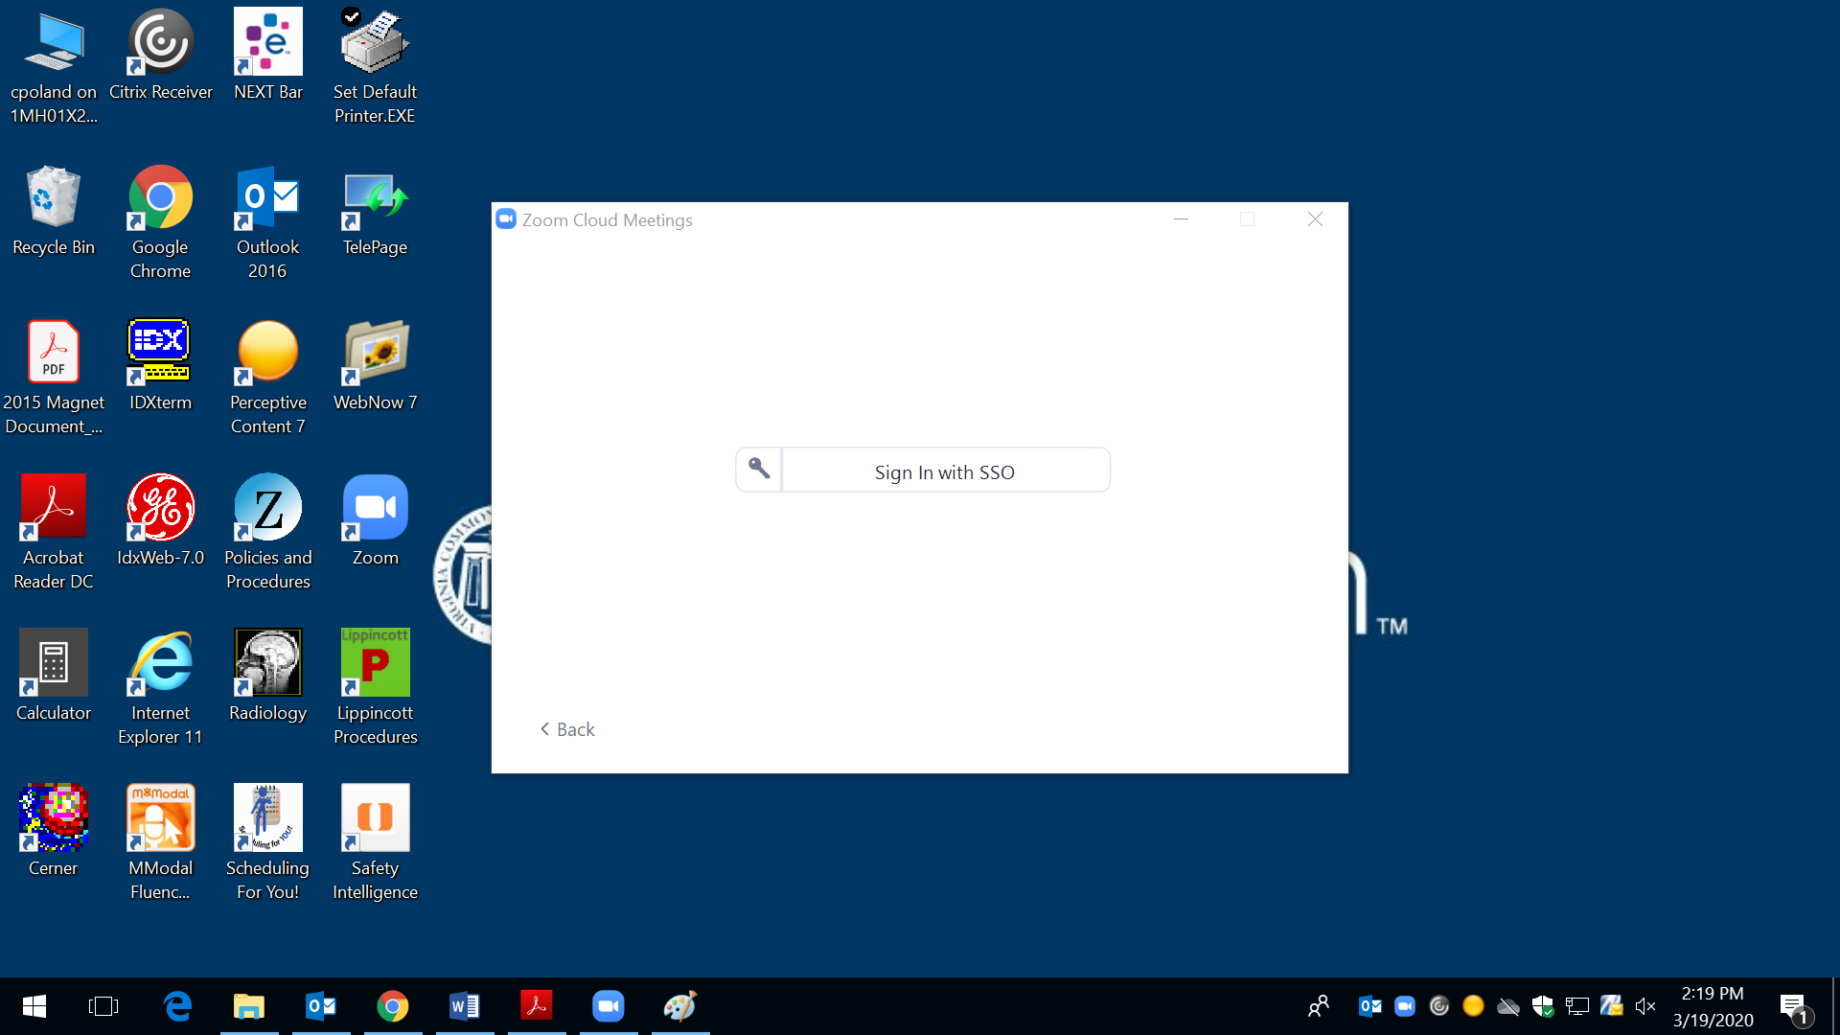
Click "Sign in with SSO"

Slide 9
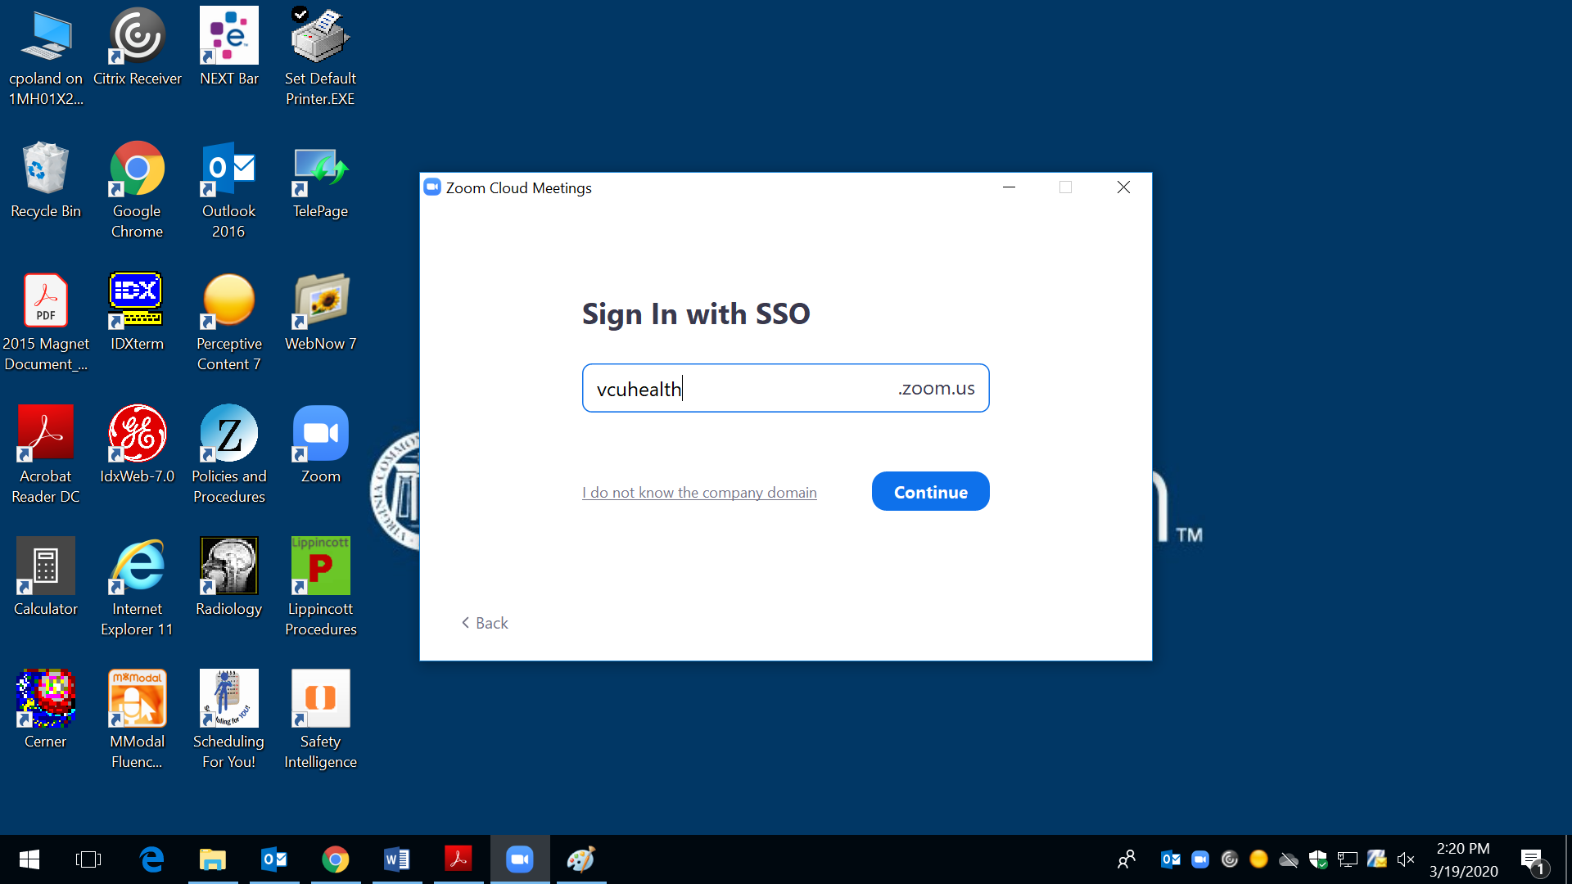
If not already completed enter "vcuhealth" in the box

Slide 10
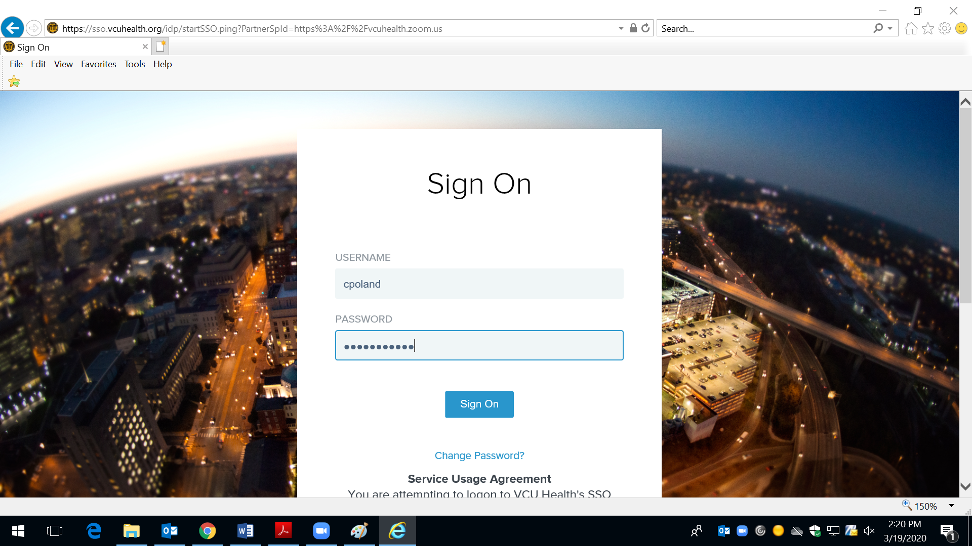
Enter your VCUHS computing ID to login

Slide 11
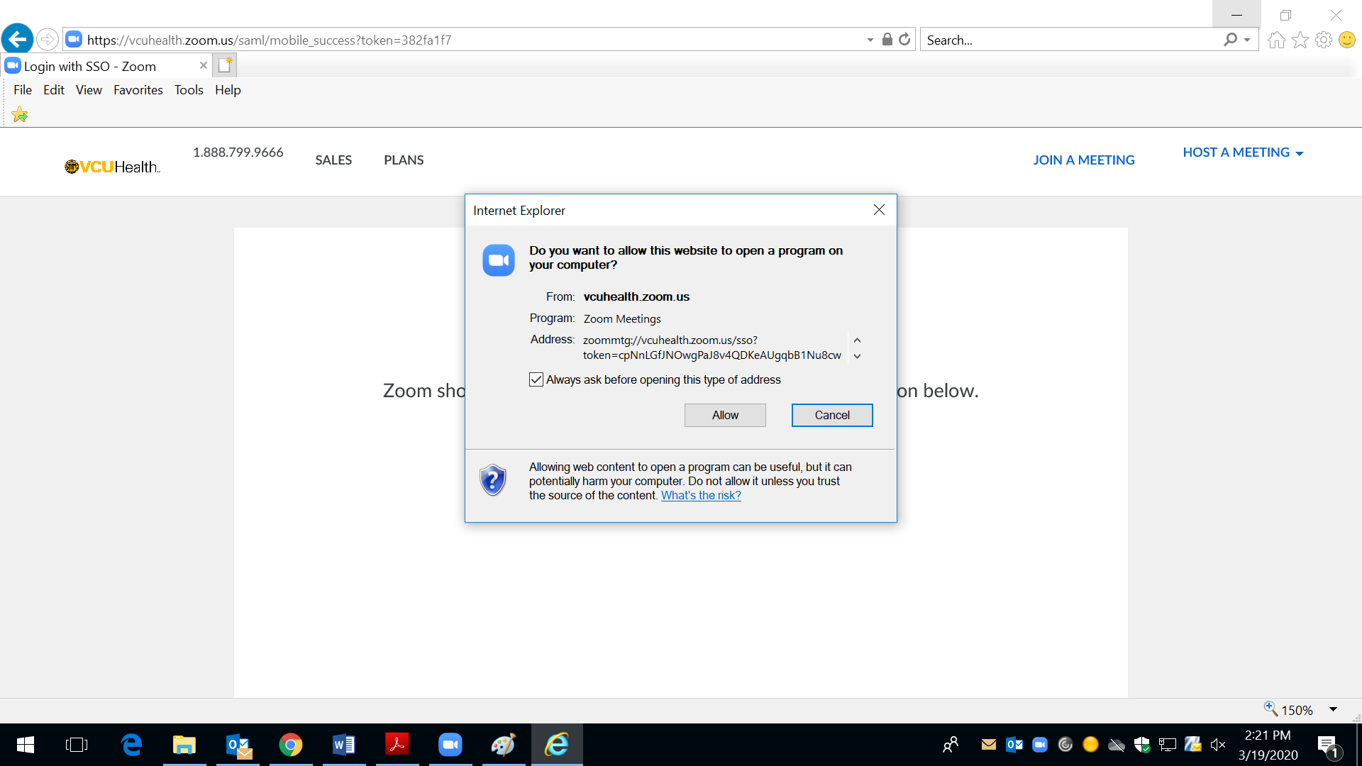
Click "Allow" to continue

Slide 12
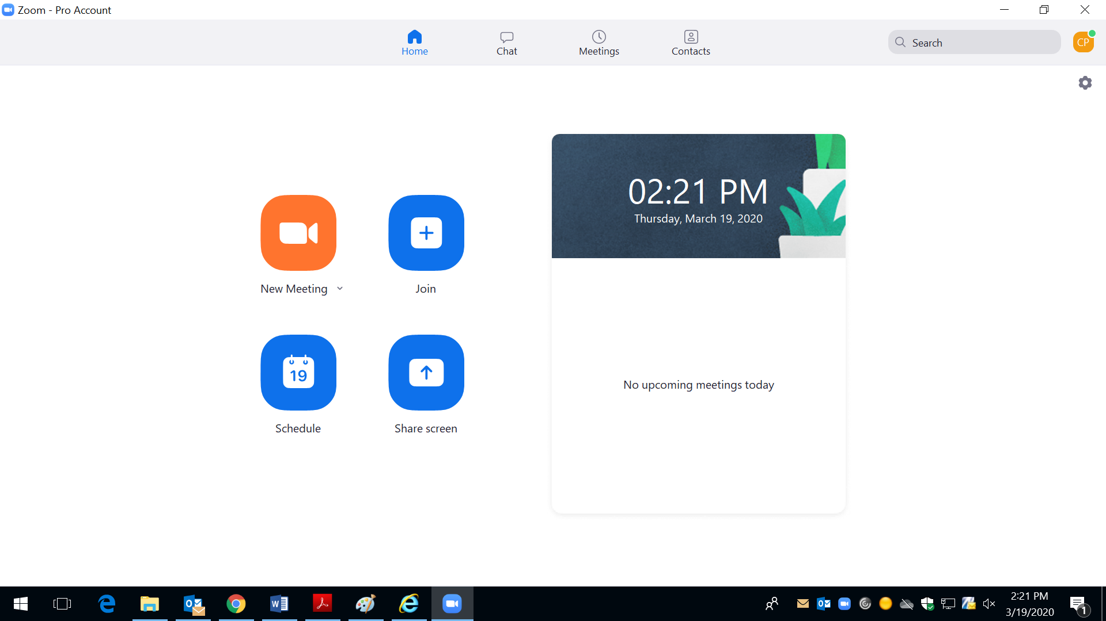
Choose "New Meeting"

Slide 13
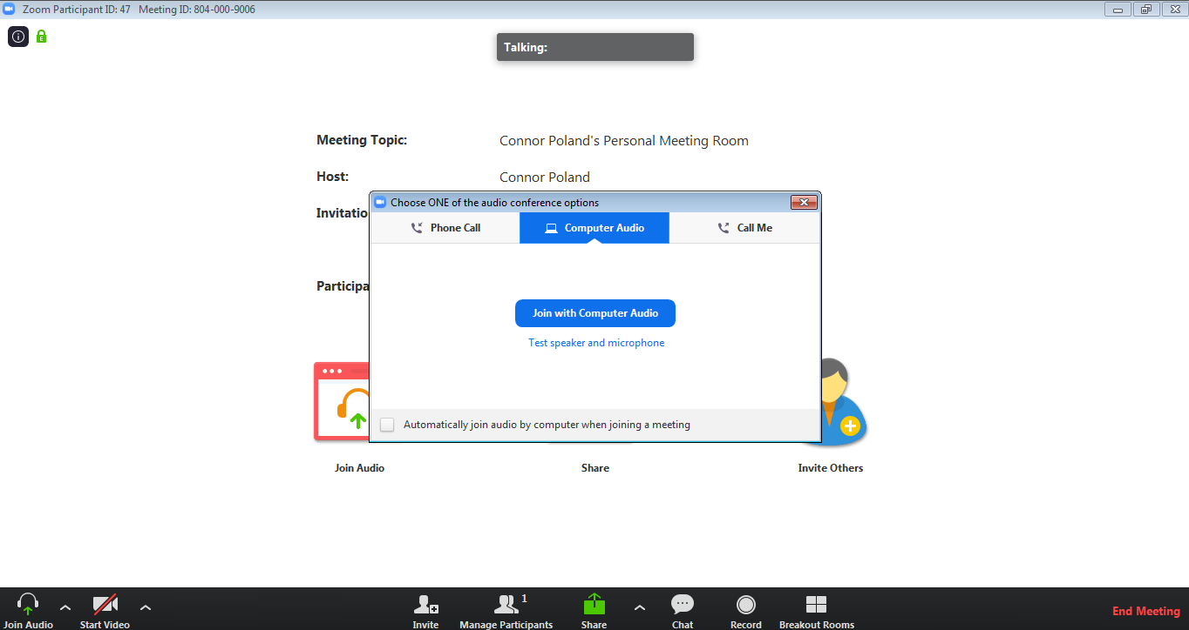
Choose your preferred audio source:
1. Computer audio -> make use of the audio input/output from your PC/Laptop
(Preferred method)
2. Phone call -> you dial into one of the phone numbers listed
3. Call Me -> enter in a phone number to have the system call YOU

Slide 14
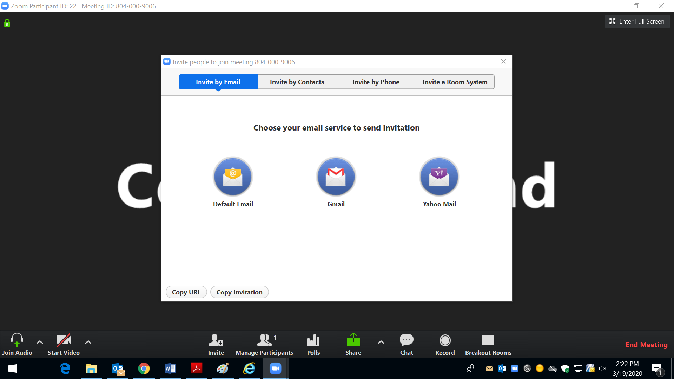
If you are not using a VCUHS Laptop or Desktop you have 2 options for email:
1. Use your personal email to send out the invitation (This will share your personal email with the patient)
2. Press "copy invitation" and paste the meeting details into your VCUHS email in another window
INVITING PATIENTS TO THE MEETING
If you are logged onto your VCUHS computer, choose the "Default email" button
NOTE: The invite by phone option only calls the patient via audio, there will be NO VIDEO of the patient if you use this option

Slide 15
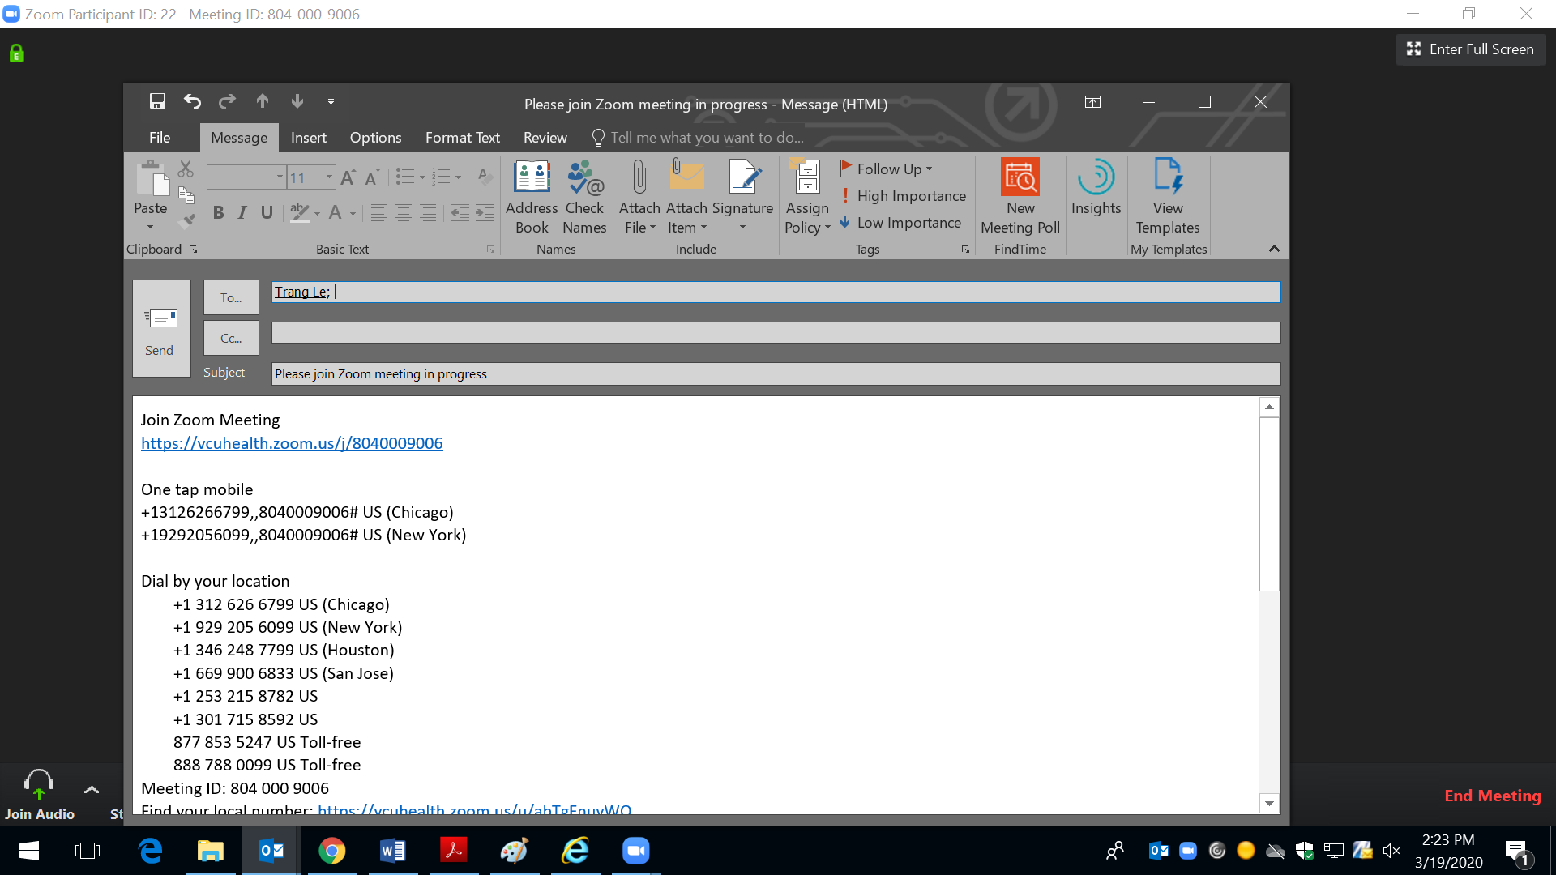
Enter in the patients email address into this email prompt, then send. The patient will be able to join via the link from their phone. (See patient workflow for more information

Slide 16
If you are not using a VCUHS Laptop or Desktop you have 2 options for email:
1. Use your personal email to send out the invitation (This will share your personal email with the patient)
2. Press "copy invitation" and paste the meeting details into your VCUHS email in another window
INVITING PATIENTS TO THE MEETING using meeting ID.
Patients can join meeting by entering 10-digit meeting ID using mobile or web app join meeting option

Slide 17
Zoom on a Mobile Device
Preferred telehealth pathway 3/18 – 3/27
Use this pathway if you are planning to see patients using your MOBILE DEVICE
Advantage: Text or email patient to connect on the go
*If you use this method, you will share your cell phone number with the meeting participants.

Slide 18
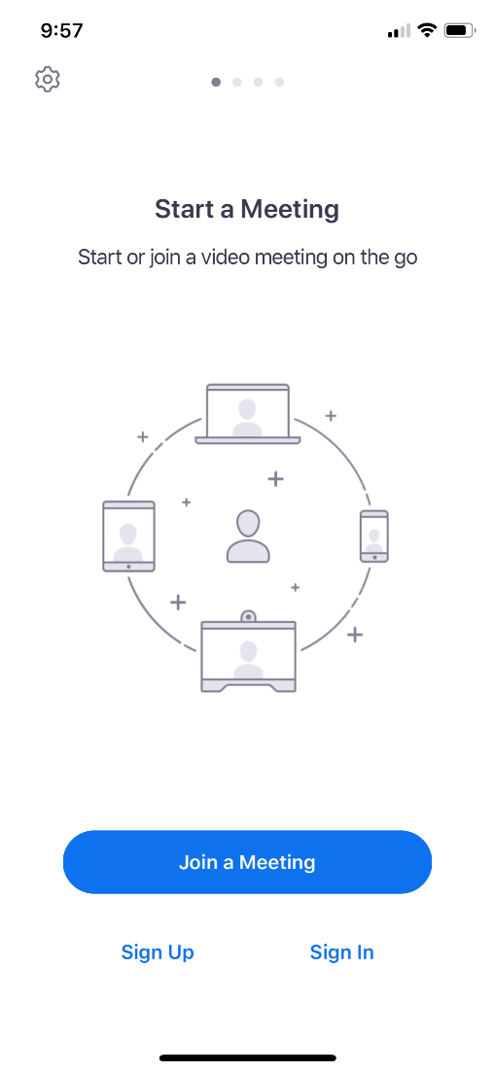
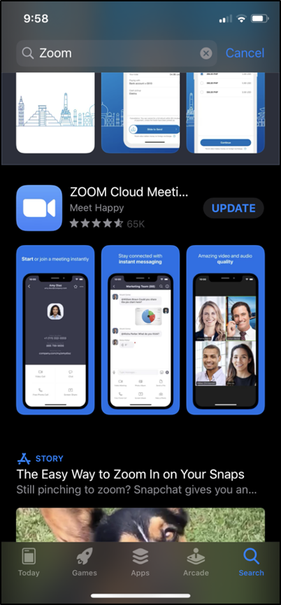
Download zoom app from app store

Slide 19
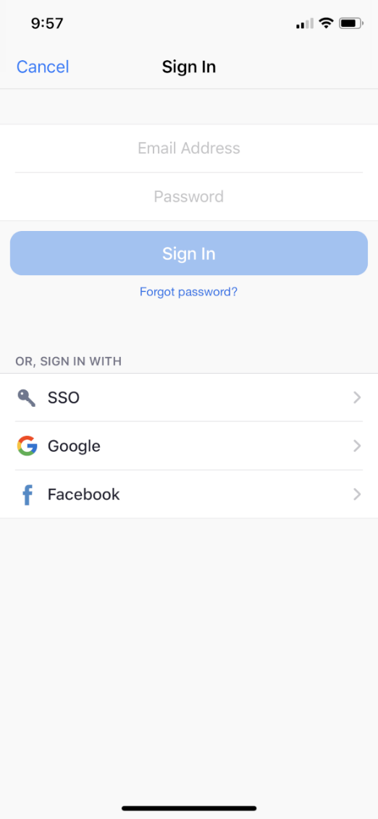
Select "SSO"

Slide 20
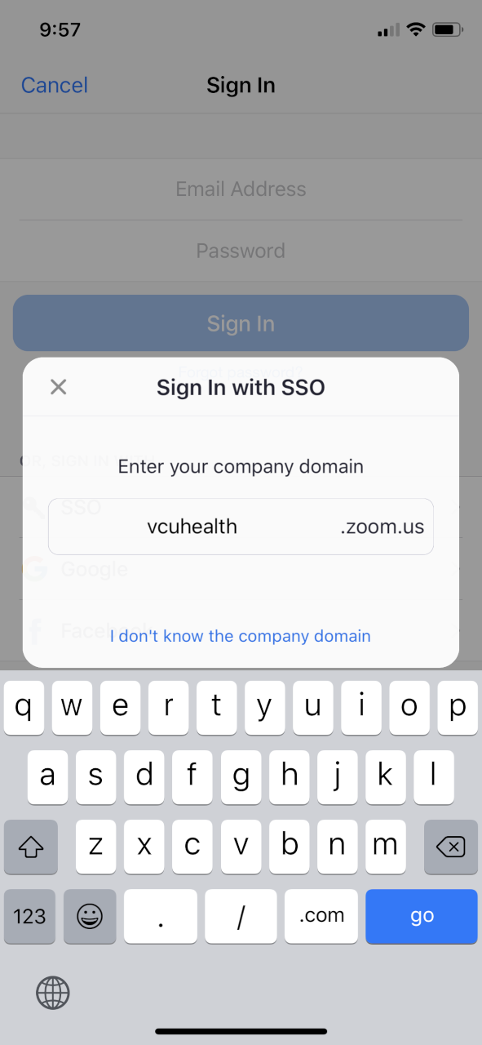
Enter "vcuhealth"

Slide 21
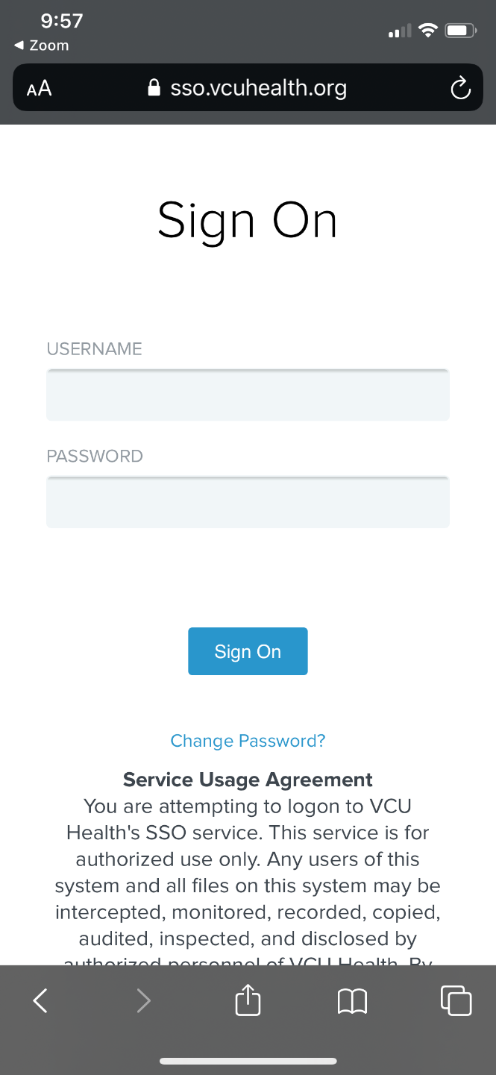
Sign in with your windows log-in
(the login used for VCUHS PCs, not your email)

Slide 22
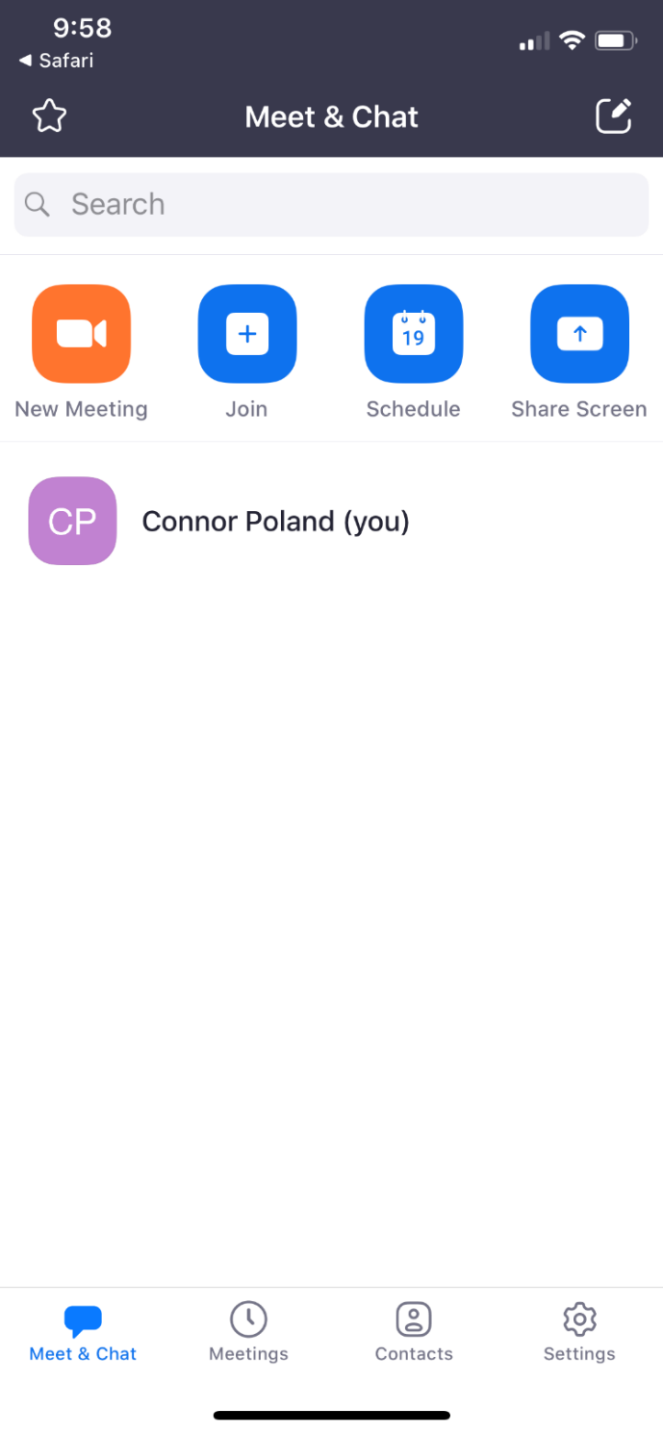
Click "new meeting"

Slide 23
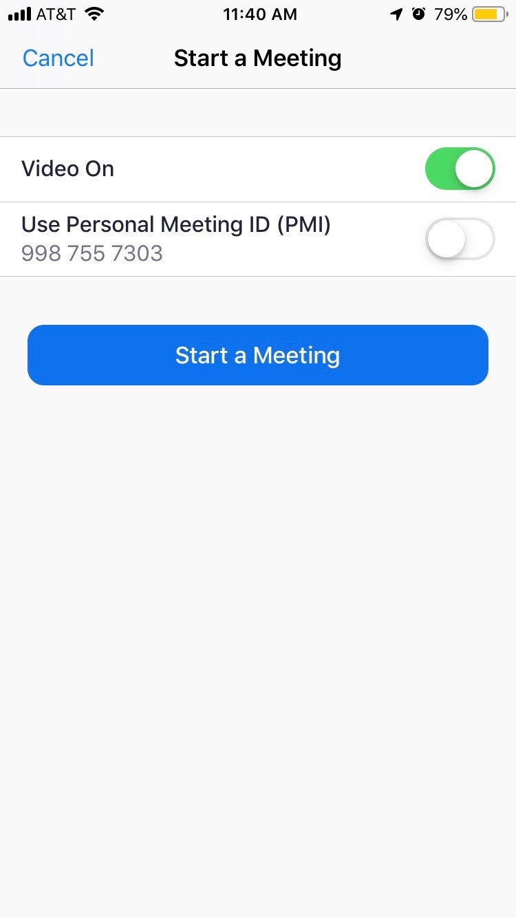
1. Make sure "Use personal meeting ID is DISABLED"
2. Click "start a meeting"

Slide 24
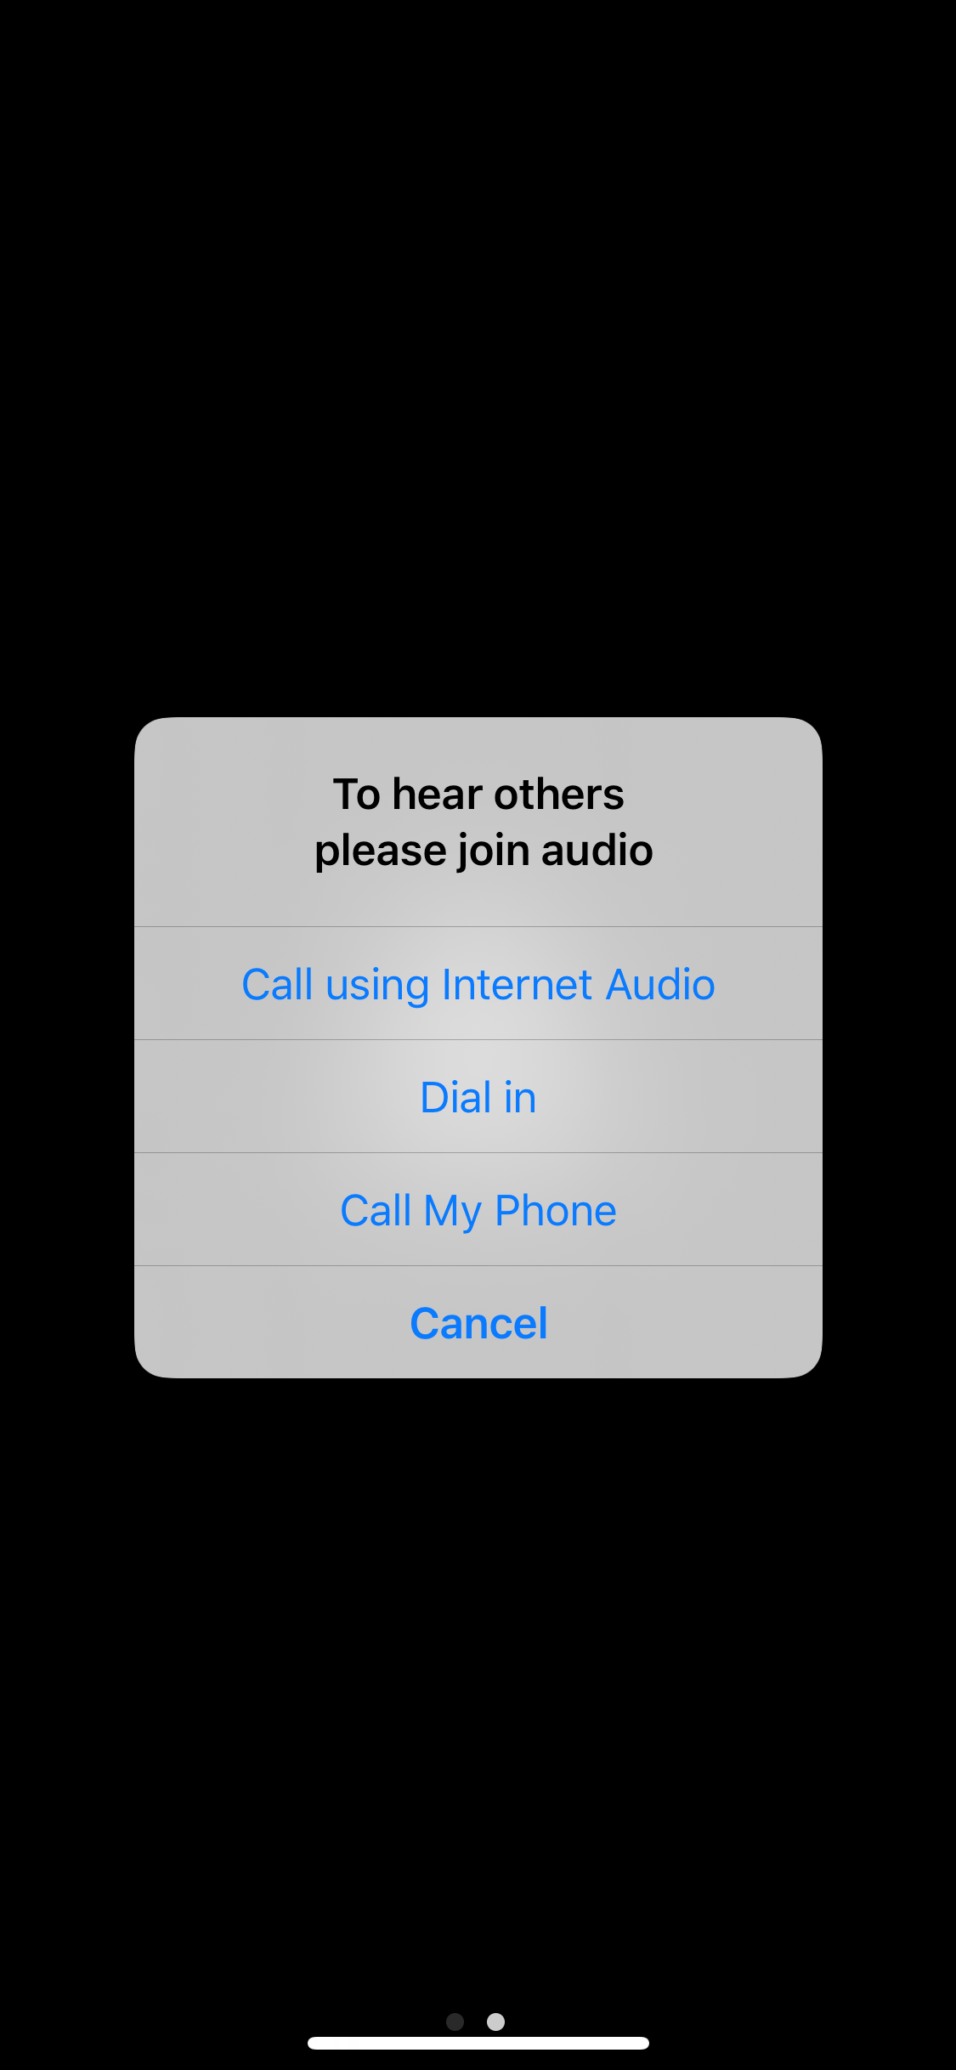
Select Call using internet audio

Slide 25
1. Tap on the screen to bring up the bottom options bar
2. Tap on participants

Slide 26
1. Tap "Invite" to bring up the invite screen

Slide 27
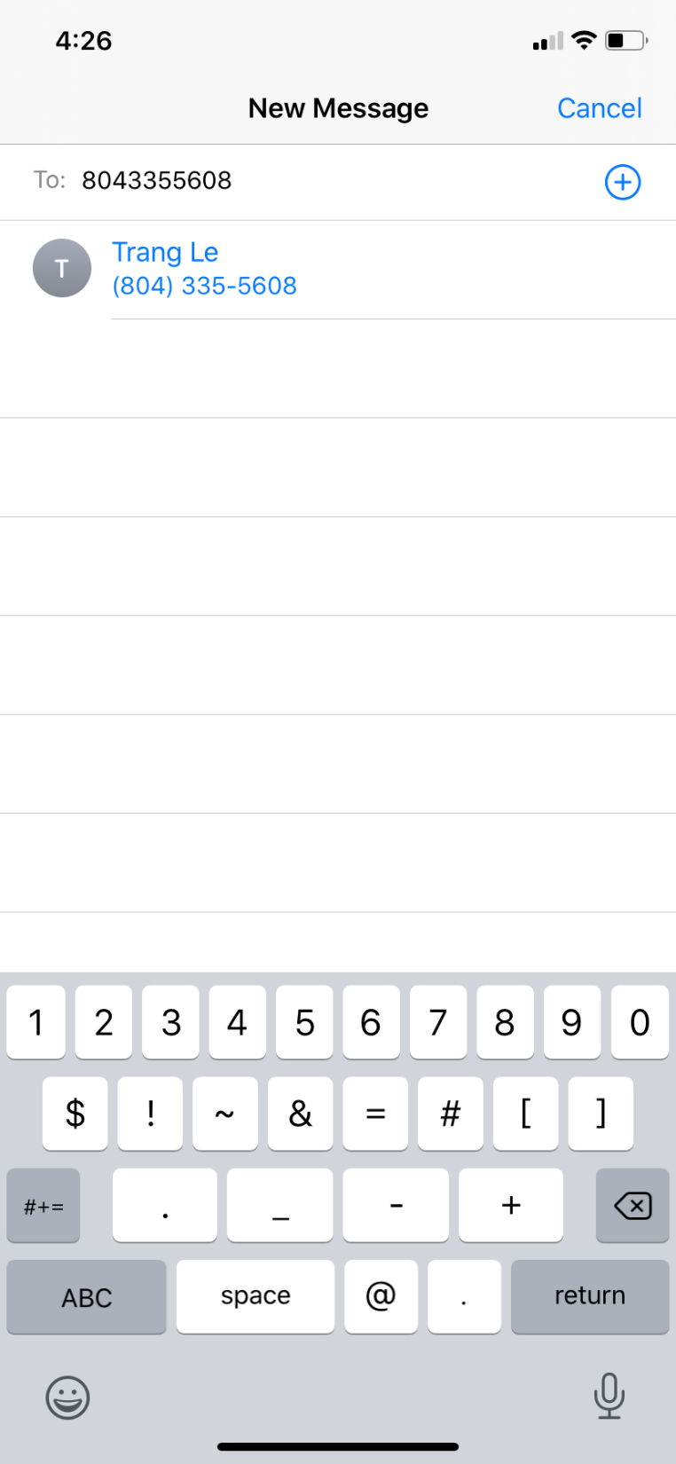
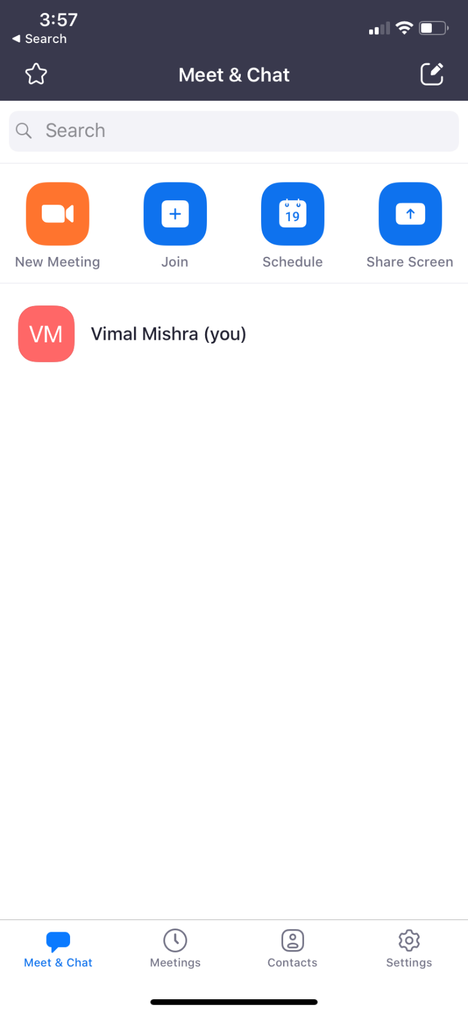
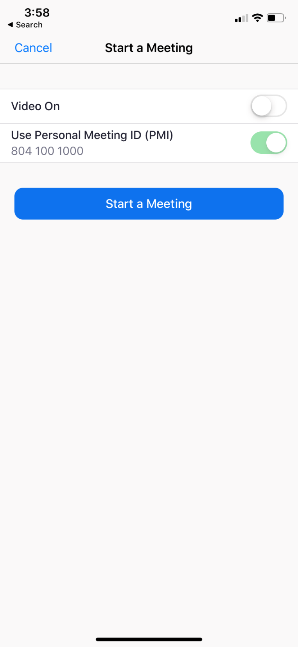
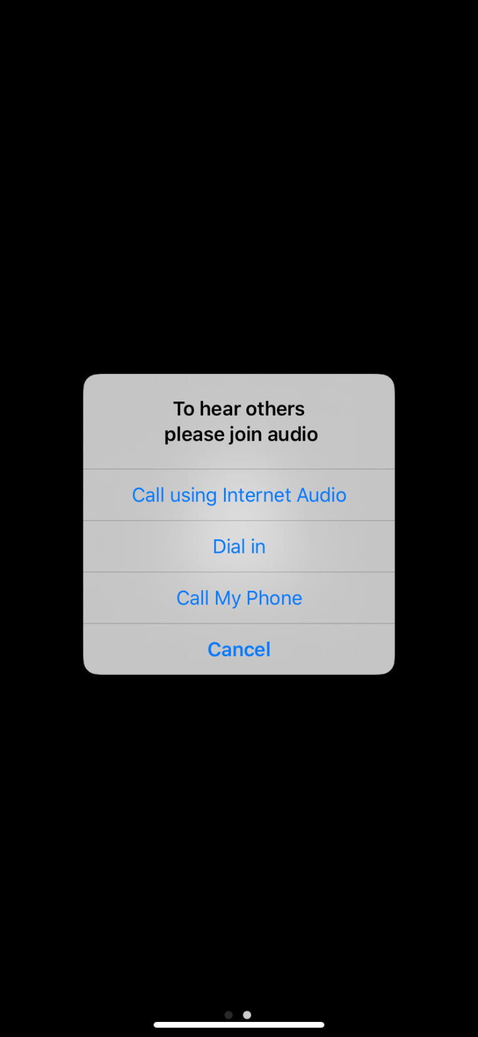
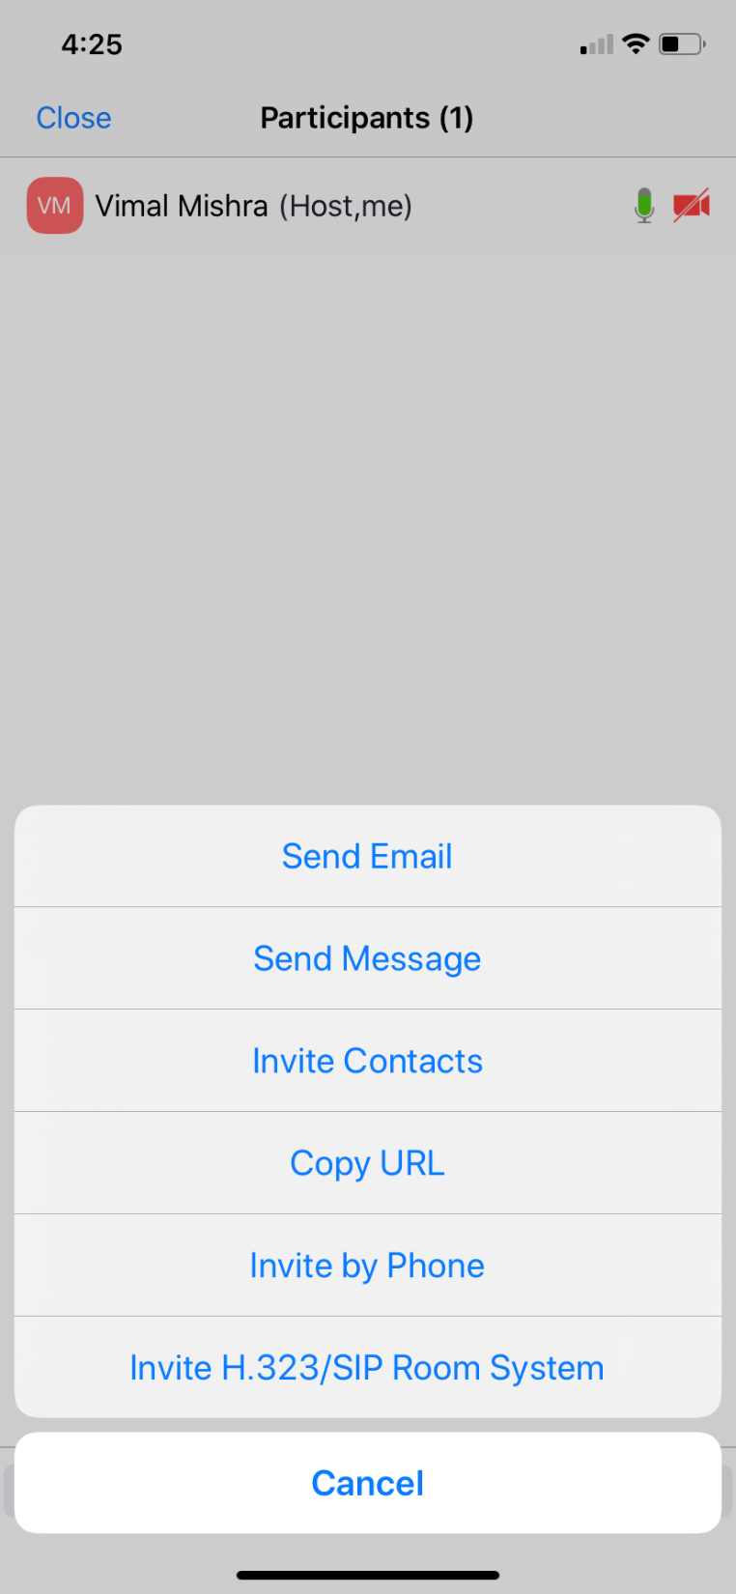
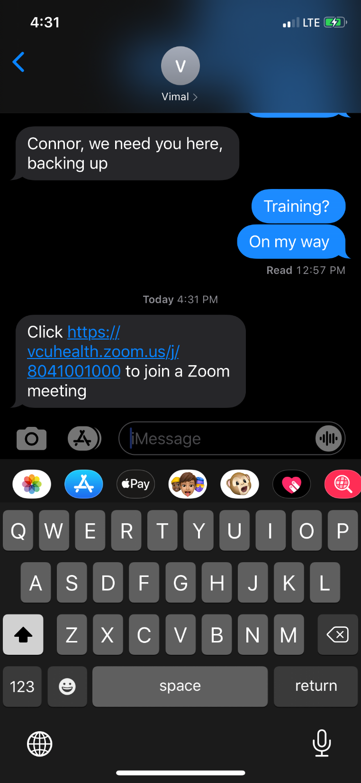
Tap send message

Slide 28
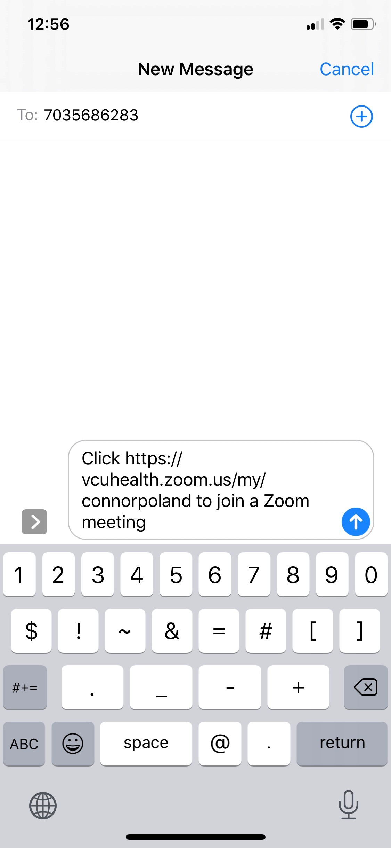
Patient Phone number goes here
Tap this when ready to send the invitation
The patient will then be invited to join the meeting

Slide 29
Patient’s Workflow (Mobile)

Slide 30
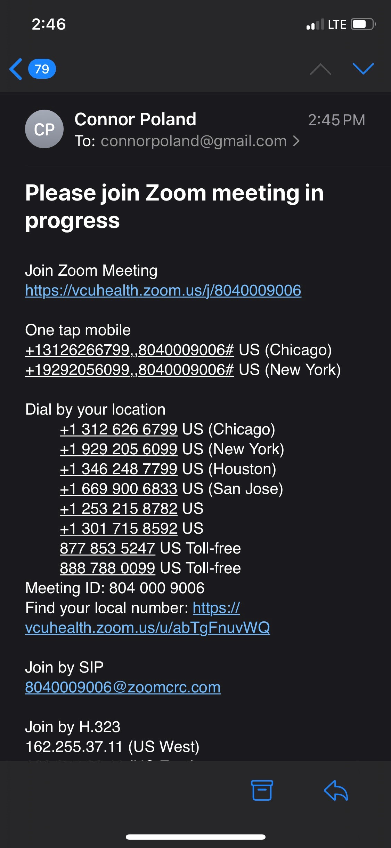
Patient clicks on the link
(If link sent via text message)
Workflow 2
Patient clicks on link
(If link sent via email)
Workflow 1

Slide 31
Download Zoom app from app store

Slide 32
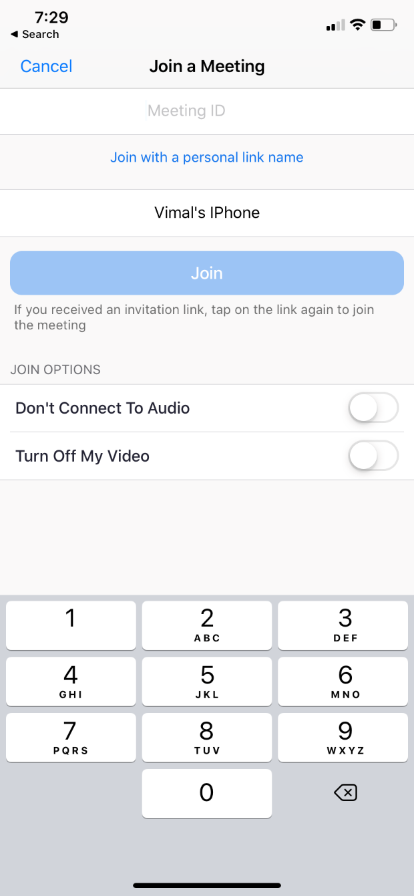
Patient enters 10 –digit zoom meeting ID

Slide 33
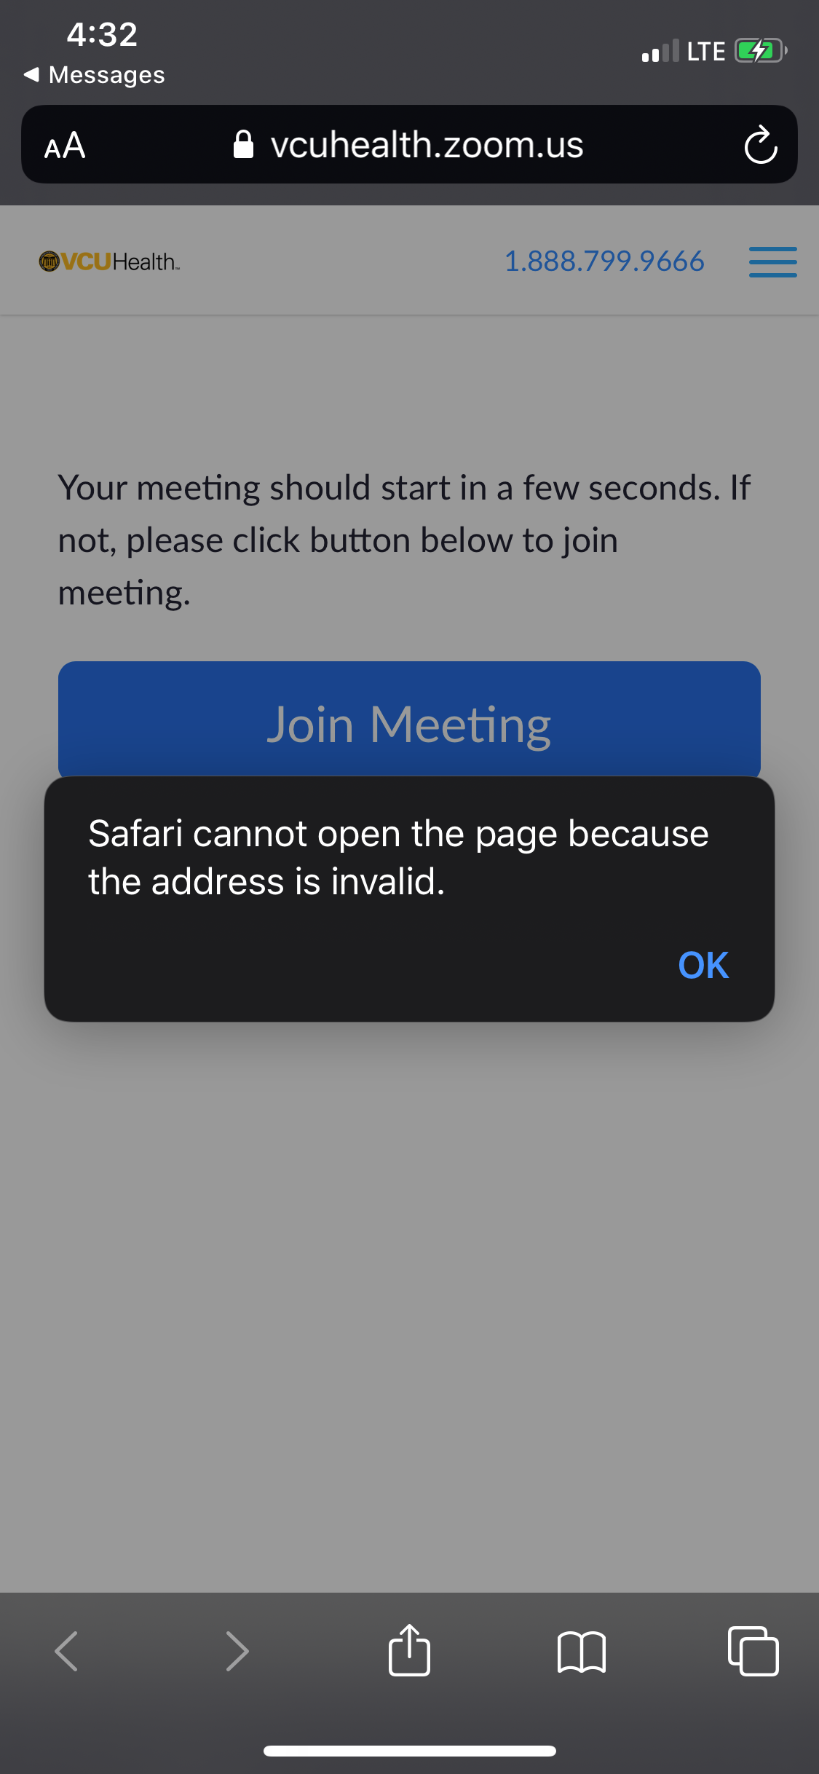
If patient doesn’t have zoom downloaded, they will get this screen, clicking ok will then prompt them to be taken to the app store to download the zoom app

Slide 34
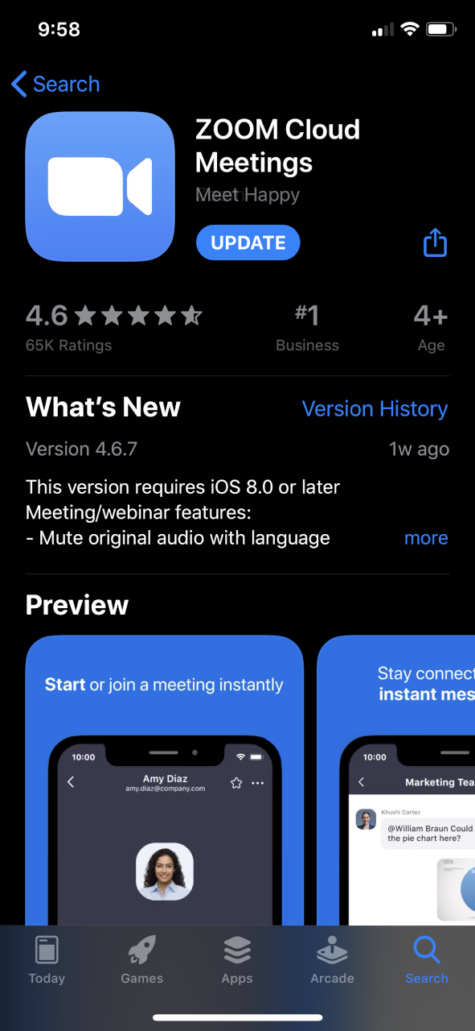
Download zoom from the app store / google play store

Slide 35
Once they download the app they must go back to the message and click the link again to join the meeting

Slide 36
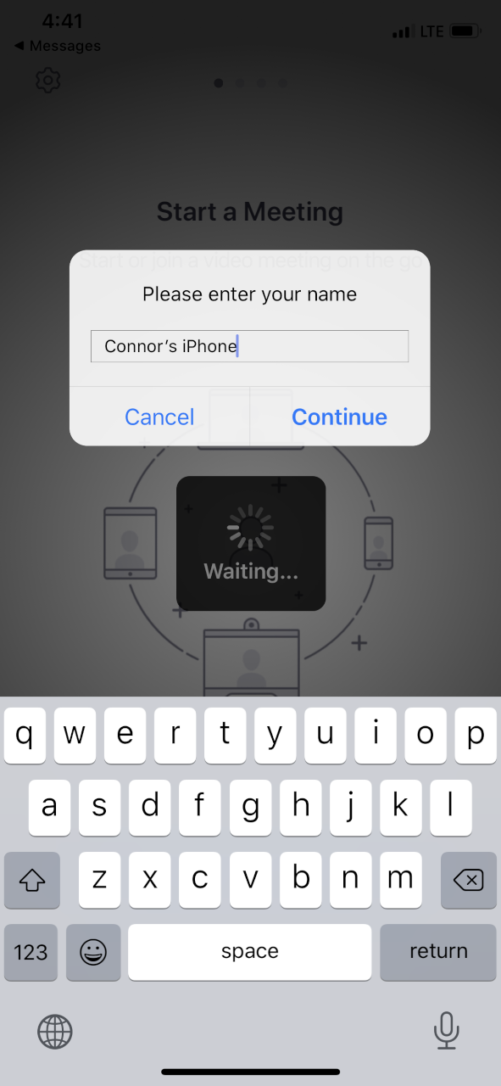
Patient does not need to create account

Slide 37
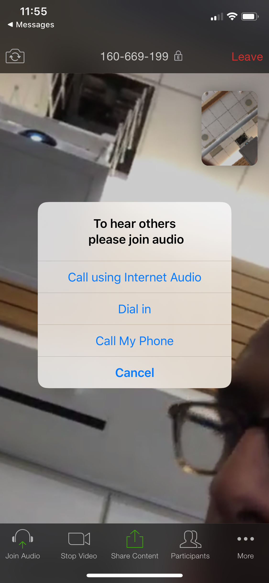
Patient connects audio via "call using internet audio"

Slide 38
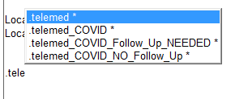
Note on documentation:
Use normal clinic note AND .telemed COVID (dot phrase) during the COVID crisis.
This will enable billing & reconciliation efforts post-crisis

